Slide 1
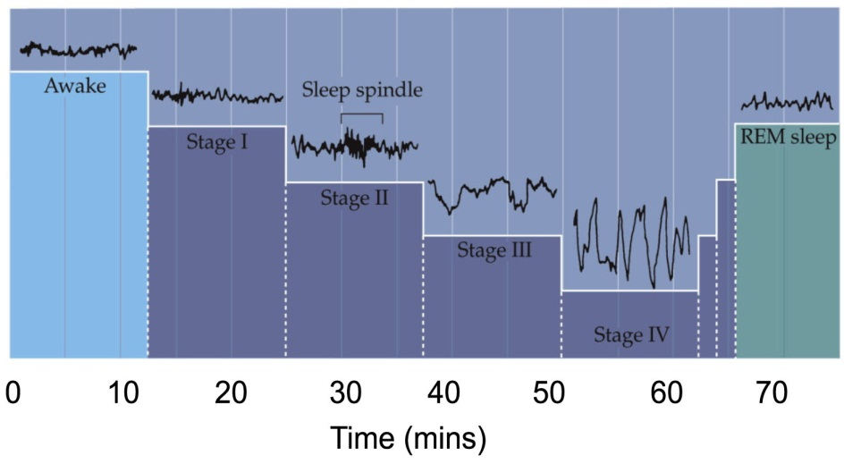
Neurological Disorders Lesson 4.2
Are you getting enough quality sleep?

Slide 2
Do Now:
Complete Part 1 of your activity worksheet. Use your sleep journal to calculate the following averages for your group. Sun/Mon-Thurs/Fri and Fri/Sat- Sat/Sun:
Total sleep time
Caffeine intake
Sleepiness scale score

Slide 3
Compile class information and calculate the class averages of:
 | Sun/Mon – Thurs/Fri |  | Fri/Sat & Sat/Sun
 | Table Averages | Class Average | Table Averages | Class Average
Total sleep time (hrs) |  | 7.04 |  | 7.75
Number of caffeinated drinks |  | 1.5 |  | 1.1
Sleepiness Scale Score | Morning: Afternoon: Evening: | Morning: 2.78 Afternoon: 2.87 Evening: 3.176 | Morning: Afternoon: Evening: | Morning: 2.038 Afternoon: 1.988 Evening: 3.075
Complete Parts 2 & 3 of your worksheets.

Slide 4
NREM and REM sleep occur in stages

Slide 5
Sleep Stages
Stages 1 & 2 – You first fall asleep but are not yet in a deep sleep.
Stages 3 &4 – You are in a deep, restful sleep. Your breathing and heart rate slow down, your body is still. It is difficult to wake someone from stages 3 & 4 sleep. It is this stage of sleep that leads to you feeling rested and refreshed. This is also the sleep stage when people sleepwalk.
Stage 5 – Your brain is active and you dream. Your eyes move under your eyelids in REM sleep. Studies have show that we consolidate and reprocess newly learned information during REM sleep.

Slide 6
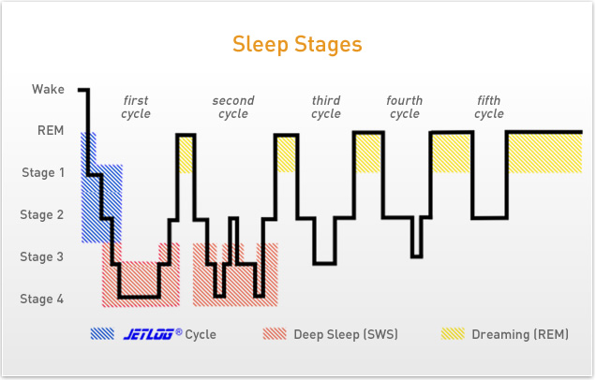
The stages occur in cycles throughout the night
Wake
1st
Cycle
2nd
Cycle
3rd
Cycle
4th
Cycle
5th
Cycle
20min
30min
50min
30min +
REM
40min
Stage 1
Stage 2
NREM
Stage 3
REM
Stage 4
Deep sleep
0
1
2
3
4
5
6
7
8
Hours After Going to Bed
Complete Part 4 of your worksheets.

Slide 7
Are you getting enough sleep?
What happens if you don’t get enough sleep?

Slide 8
Homework: Part 5 of your worksheet
Write a report about how your sleep patterns correlate with your behavior. Use one paragraph for each of the following questions:
Are you and the class getting enough total sleep?
How does your sleep behavior at the weekends relate to your behavior during the week?
What are the correlations between sleep patterns and other behaviors – drinking caffeinated beverages and sleepiness scale score?

